Slide 1
FULFILLMENT &
LOGISTICS
DATABASE PROJECT
MySQL Database Design, Queries & Data Retrieval
PRESENTER: AMPWERA JAVAN
GROUP PROJECT: ONLINE SHOPPING
AREA OF INTEREST: FULFILLMENT AND LOGISTICS

Slide 2
ABOUT THE DATABASE
I was able to create a database called fulfillment_logistics_v2
it is a database that handles how the the part from when the customer makes his order untill his order is delivered
it is able to store the customer's orders and even they track their orders

Slide 3
DATABASE OVERVIEW
CUSTOMER
ORDERS
ORDER_ITEM
INVENTORY
6 customers stored
7 orders tracked
10 line items
5 products
SHIPMENT
SHIPMENT_ITEMS
DELIVERY
RETURNS
8 shipment records
Shipment details
5 deliveries
2 return records

Slide 4
TABLE RELATIONSHIPS
CUSTOMER
ORDERS
ORDER_ITEM
CustomerID
OrderID
OrderItemID
Name
CustomerID
OrderID
PhoneNumber
OrderDate
ProductID
Email
Status
Quantity
Address
AmountPaid
Subtotal
SHIPMENT
DELIVERY
INVENTORY
ShipmentID
DeliveryID
ProductID
OrderID
OrderID (FK)
ProductName
Carrier
DeliveryStatus
StockLevel
ShipmentStatus
UnitCost
FK = Foreign Key | PK = Primary Key | Lines indicate table relationships

Slide 5
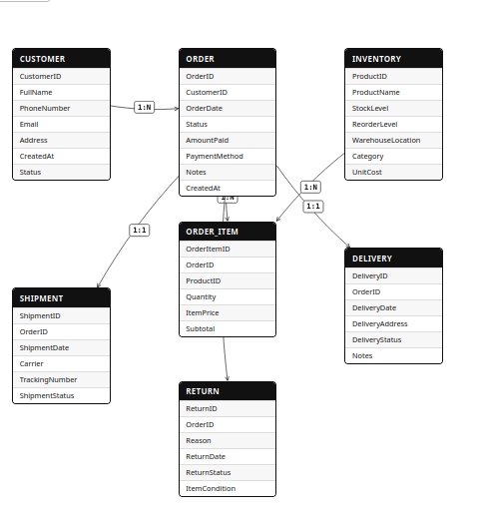
THE ER DIAGRAM OF THE DATABASE

Slide 6
BASIC DATA RETRIEVAL QUERIES
show databases; - to find your database
use fulfillment_logistics_v2; - selecting the database
Retrieve All Customers
SELECT * FROM CUSTOMER;
All Orders with Customer Details (JOIN)
SELECT C.Name, O.OrderID, O.OrderDate, O.Status, O.AmountPaid FROM ORDERS O JOIN CUSTOMER C ON O.CustomerID = C.CustomerID;
Filter Pending Orders
SELECT * FROM ORDERS WHERE Status = 'PENDING';

Slide 7
advantages otf this database
using querries one is able obtain specific information from the database
Easy Tracking of Order Status
Clear Separation of Responsibilities

Slide 8
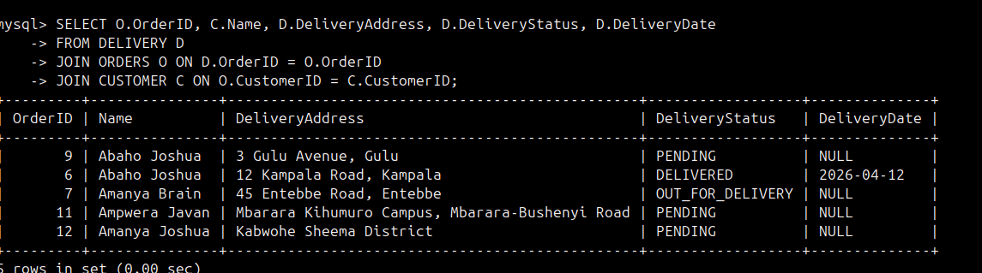
DELIVERY & SHIPMENT TRACKING QUERIES
Track Order Delivery Status

Slide 9
QUERY REFERENCE SUMMARY
# | Query Purpose | SQL Concepts Used | Tables
Q1 | Retrieve all customers | SELECT * | CUSTOMER
Q2 | Orders with customer names | JOIN, SELECT columns | ORDERS, CUSTOMER
Q3 | Filter pending orders | WHERE, enum filter | ORDERS
Q4 | Revenue per customer | GROUP BY, SUM, ORDER BY | ORDERS, CUSTOMER
Q5 | Full order breakdown | 3-Way JOIN | ORDER_ITEM, ORDERS, CUSTOMER, INVENTORY
Q6 | Low stock alert | WHERE, ORDER BY | INVENTORY
Q7 | Track delivery status | JOIN, SELECT | DELIVERY, ORDERS, CUSTOMER
Q8 | Active shipments | WHERE, enum filter | SHIPMENT
Q9 | Returns + refund status | JOIN | RETURNS, ORDERS
Q10 | Inventory value report | Computed column, ORDER BY | INVENTORY

Slide 10
PROJECT SUMMARY
What this database system achieves:
Order Management
Tracks customer orders from placement through delivery with status enum control
Inventory Control
Monitors products with stock levels, warehouse locations & unit costs
Shipment Tracking
Manages carriers (SafeBoda, DHL, G4S) with tracking numbers per order
Returns Processing
Handles cancellations & returns with condition assessment & refund workflow
Business Insights
SQL aggregate queries reveal revenue trends, top customers & stock alerts

